Slide 1
Chapter 1.2 Introduction to Software Construction
CCSW 325 (Software Construction)
Notes:
Last Update: 22/8/2019
Version 1.0

Slide 2
Outline
Software Construction Definition
What is Software Construction?
Why is Software Construction Important?

Slide 3

What is Software Construction?

Slide 4
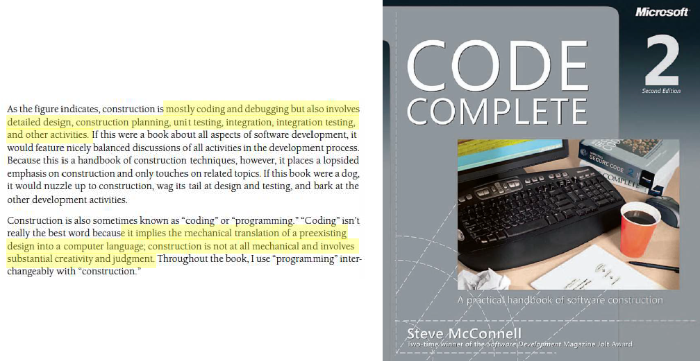
What is Software Construction?
.

Slide 5
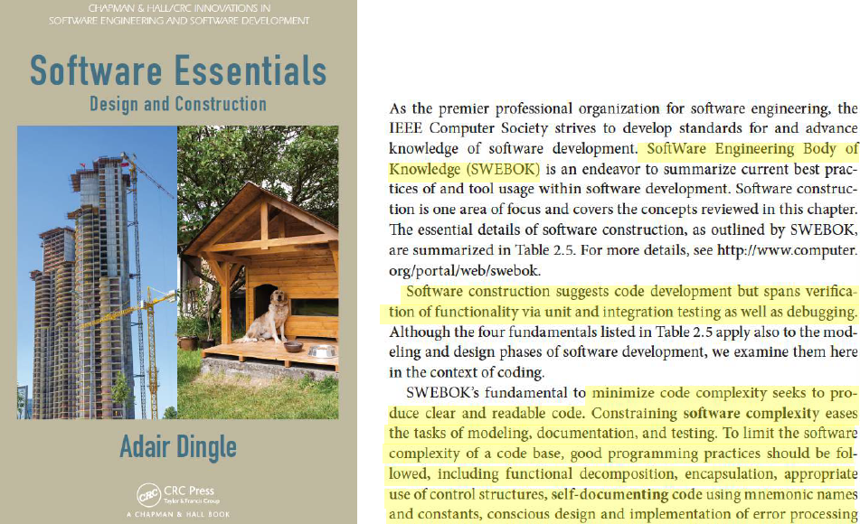
What is Software Construction?

Slide 6
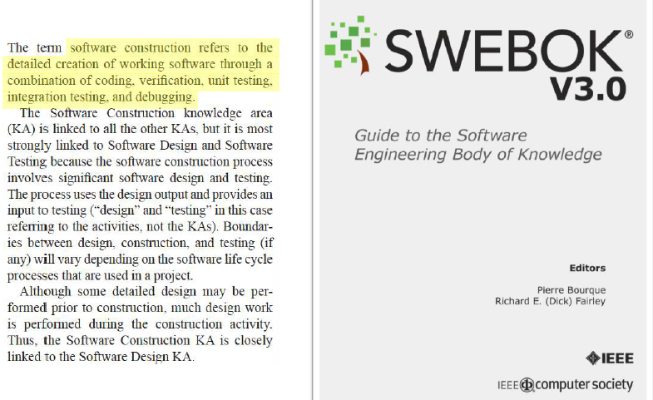
What is Software Construction?

Slide 7
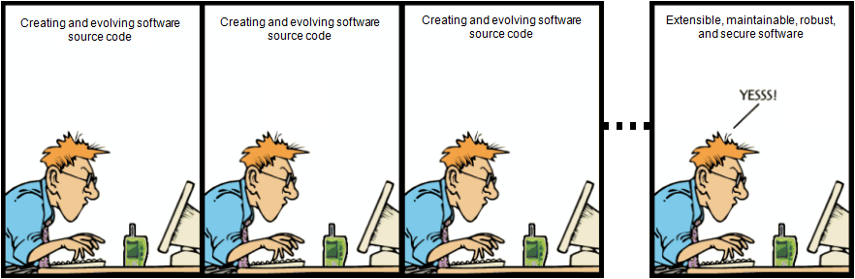
What is Software Construction?
Software construction is the process of creating and evolving software source code that results on extensible, maintainable, robust, and secure software.

Slide 8
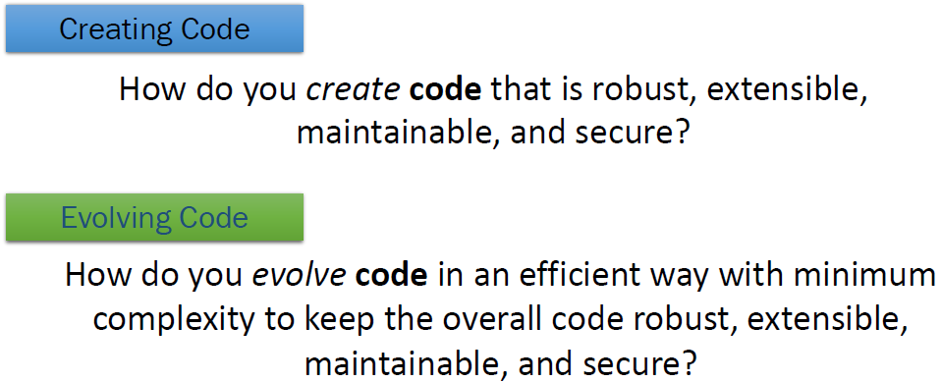
What is Software Construction?

Slide 9
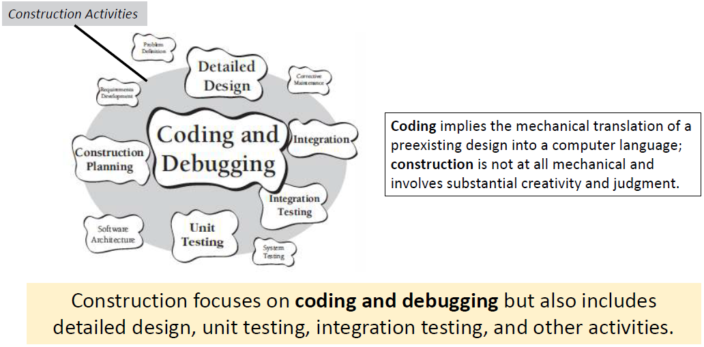
What is Software Construction?

Slide 10
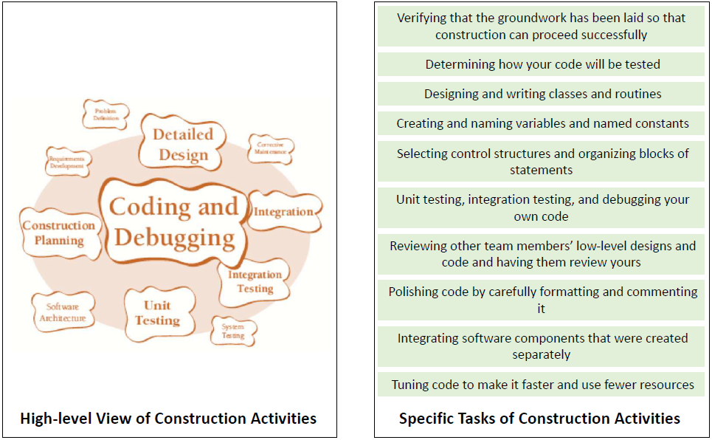
What is Software Construction?

Slide 11
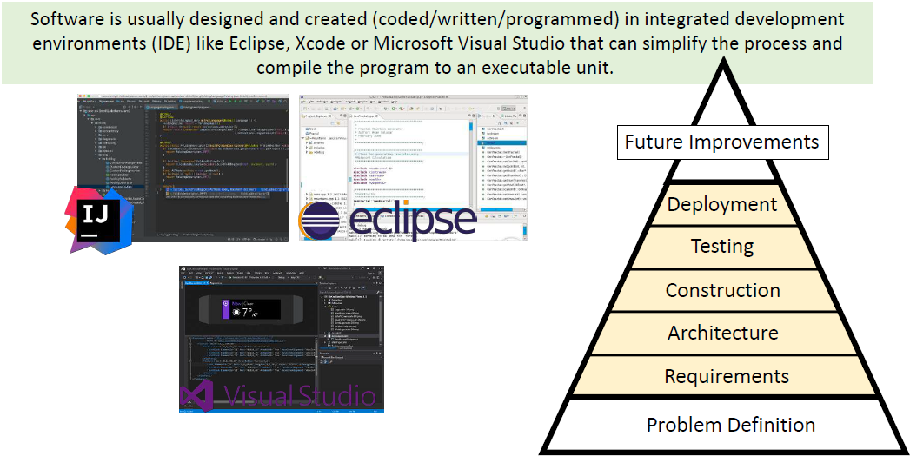
What is Software Construction?

Slide 12
Why is Software Construction Important?

Slide 13
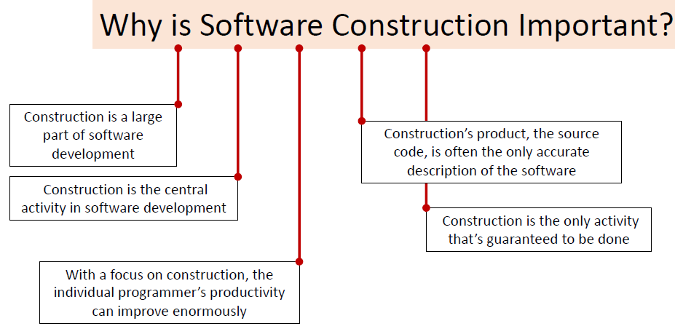
Why is Software Construction Important?

Slide 14
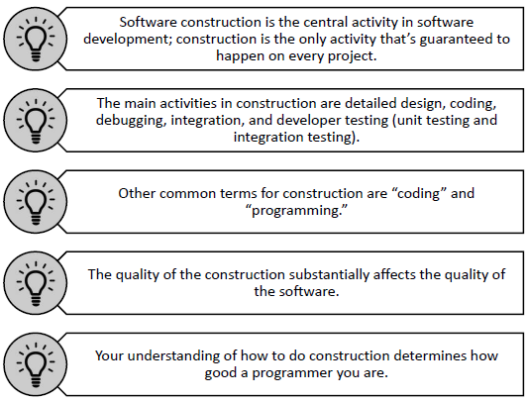
Summary

Slide 15
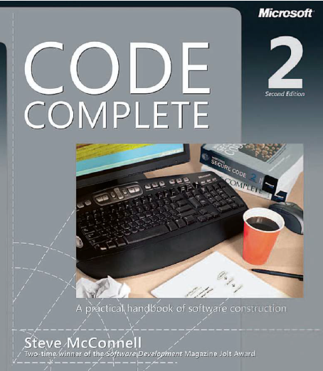
Reading
Code Complete: A Practical Handbook of Software Construction, 2nd Edition, Steve McConnell.
Chapter 1

Slide 16

Any questions? ​
Please feel free to raise your hands and ask.

